Slide 1





Sales and Order
Management System
NorthWind Traders
Mail: gowthamfencing77@gmail.com
Linkedin: Gowtham B M
B M GOWTHAM
APRIL 2025

Slide 2

Introduction
This project focuses on analyzing and managing sales and order data using a structured relational database system. The aim is to understand customer behavior, product performance, and sales trends by exploring a sample dataset that mimics a real-world business environment.
By using tools like Microsoft Excel and Power BI, the project transforms raw data into meaningful insights through data modeling, KPI tracking, and dashboard visualizations.
This approach helps demonstrate how data-driven decisions can improve business efficiency and customer satisfaction
Purpose
Analyze and visualize sales and order data
Track KPIs like total sales, top products, and customer trends
Improve business understanding through data relationships
Present insights using an interactive dashboard
Tools Used
Microsoft Excel – for data cleaning, tabulation, and basic analysis
Power BI – for creating interactive dashboards and visual reports
SQL (Structured Query Language) – for querying and managing relational data
Entity-Relationship (ER) Diagrams – to understand table relationships and database design

Slide 3



Dataset Description
Dataset Description
The project uses a sample sales and order management dataset that simulates a real-world business scenario.
The data is organized into multiple relational tables including:
Customers – Customer details and contact information
Orders – Order dates, shipping info, and customer linkage
Order Details – Product-wise order information (quantity, price, discount)
Products – Product names, categories, pricing, and stock
Employees – Staff handling orders
Suppliers, Shippers, and Categories – Supporting business information
Each table is connected using primary and foreign keys (e.g., OrderID, ProductID, CustomerID)

Slide 4


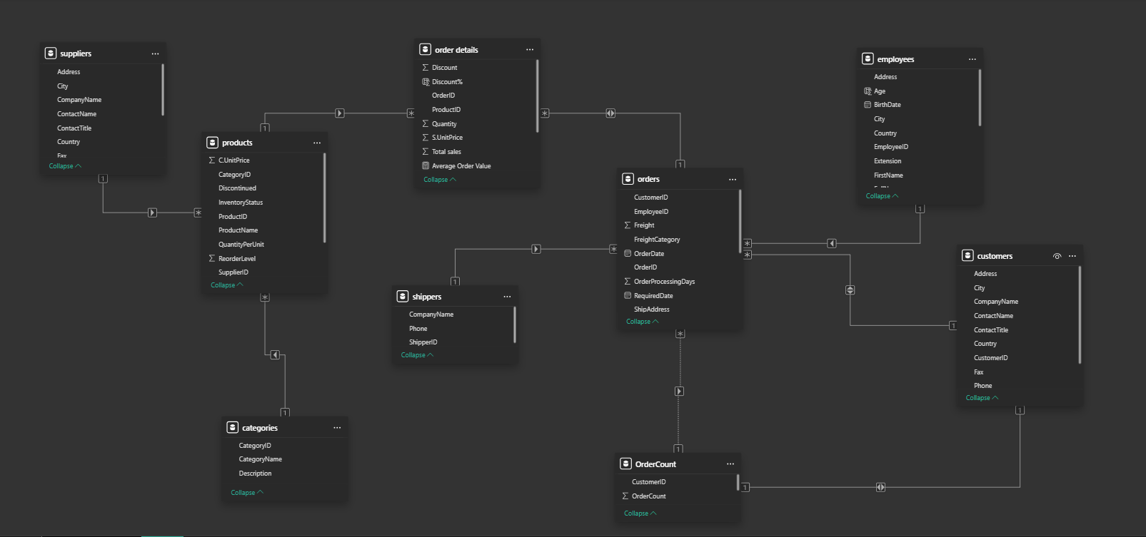


Database Schema
Students, Young Professionals
Behavioral Traits

Slide 5



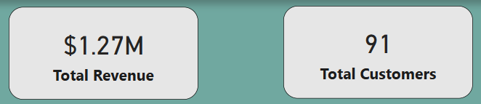
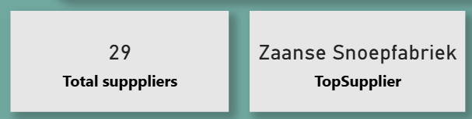
Key Metrics and KPIs
Total Sales Revenue – Sum of all sales transactions
Total Orders – Number of orders placed
Top-Selling Products – Based on quantity sold or
revenue
Top Customers – Based on total purchase value
Region/Country-wise Sales – Sales performance by
geography
Order Volume by Employee – Track performance of
sales staff
Freight Cost Analysis – Evaluate shipping expenses
Average Order Value – Total sales divided by
number of orders
Screenshots

Slide 6



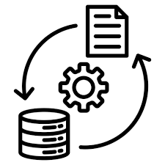

Data Analysis
In this project, a systematic approach was followed to clean, model, and analyze the data for meaningful business insights.
Data Cleaning:
Removed duplicate records and handled missing or null values
Standardized data formats for consistency (e.g., dates, currency, text casing)
Ensured valid entries in key columns (e.g., OrderID, ProductID, CustomerID)
Data Modeling:
Defined relationships between tables using primary and foreign keys
Created a star schema in Power BI for efficient report building
Verified referential integrity across linked tables
Data Transformation:
Calculated new fields such as Total Sales (Quantity × UnitPrice)
Created custom columns for profitability, order status, etc.
Applied filtering logic to isolate trends (e.g., top customers, high-revenue periods)
Data Aggregation & Analysis:
Grouped data by product, customer, region, and time
Used DAX formulas and Excel pivot tables to summarize metrics
Built interactive visuals like charts, slicers, and KPIs for user-friendly exploration
This process enabled accurate, actionable insights and a robust dashboard that reflects real-world business
scenarios.

Slide 7
Challenges
Solutions
Inconsistent or Missing Data
Null values and formatting issues in the raw dataset
1
Cleaned and standardized data using Excel functions and Power BI Power Query
Complex Table Relationships
Establishing correct links between multiple tables
2
Designed a relational schema and used primary-foreign key relationships effectively
Performance in Large Reports
Slow visuals in Power BI due to large datasets
3
Optimized data model using filters and summarized data where possible
Designing Meaningful KPIs
Choosing relevant and actionable performance indicators
4
Selected KPIs based on business goals (sales, customer trends, region analysis)
Visual Design Consistency
Creating a clear and user-friendly dashboard layout
5
Used consistent color schemes, labels, and interactive elements like slicers

Slide 8


DASHBOARD
PREVIEW
The final output of this project is an interactive dashboard built using Microsoft Power BI

Slide 9
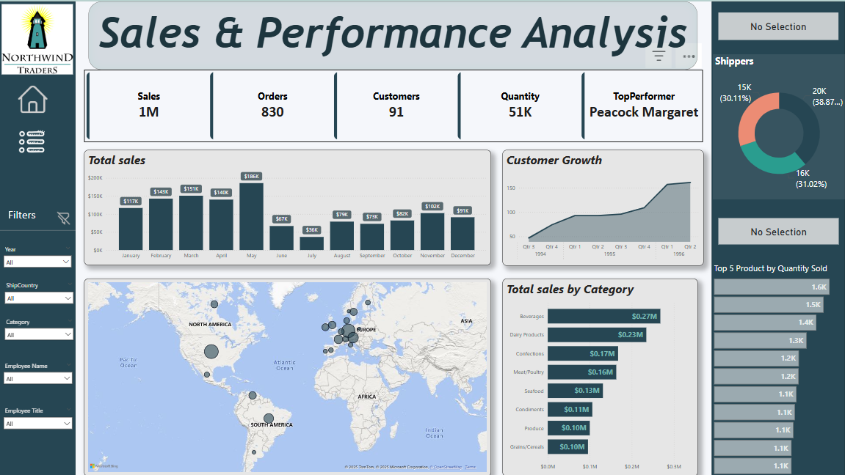


Slide 10

Dashboard Features
01
02
Slicers and filters
03
Visual representation
Drill-down
For selecting specific time periods, regions or product categories
Capabilities to analyze trends over time
Total Sales ,Order Count, Top Products
04
Benefits
05
Dynamic
06
Map
Easy to monitor
Interactive elements
Clean and organized layout
Bar charts, Line graphs, and cards showing KPIs
Region-wise sales map
for geographic insights

Slide 11
Power BI Problem
Statements

Slide 12
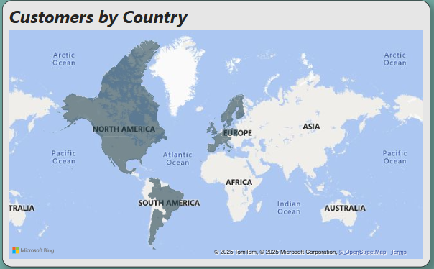
How does customer distribution vary across different regions or customer segments? Can we visualize it on a map or bar chart?
The analysis of customer distribution across different regions or customer segments reveals clear patterns in customer concentration. Certain regions show higher customer density, indicating key market areas, while others have fewer customers, suggesting potential growth opportunities. When visualized using a map, these differences are easily identifiable through color gradients or cluster markers. Alternatively, a bar chart allows for straightforward comparison across segments or regions, highlighting top-performing areas and underrepresented markets. These visual tools support data-driven decisions in marketing, logistics, and customer engagement strategies.

Slide 13
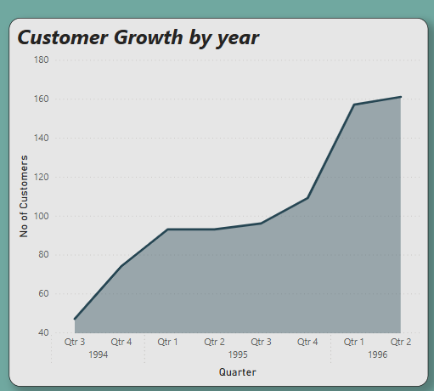
What is the trend in customer acquisition over time? Can we create a line chart or area chart to display it?
From Q3 1994 to Q1 1995, there's a sharp growth in the number of customers.
Between Q1 1995 and Q3 1995, growth slows and plateaus.
From Q3 1995 to Q1 1996, there's another steep rise in customer acquisition.
Growth stabilizes slightly in Q2 1996, maintaining a high customer count (~160).

Slide 14
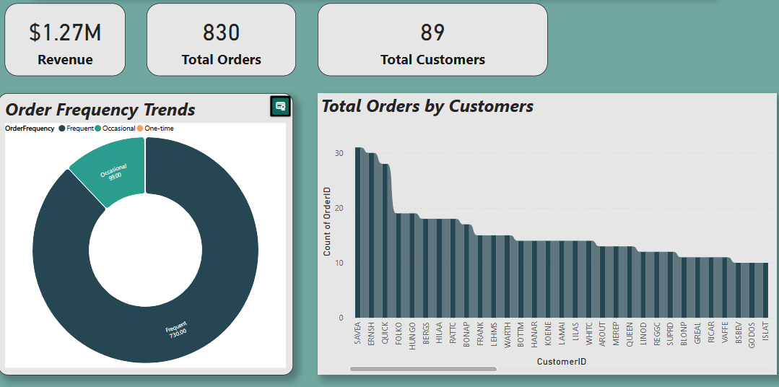
Can we visualize the distribution of customer demographics such as age, gender, or income using histograms or pie charts?
Visualizing customer demographics through histograms and pie charts provides deeper insights into the customer base. Age and income histograms reveal the most represented groups, while gender pie charts highlight the proportion of male, female, or other customers. Combined with order frequency trends, these visuals can uncover behavioral patterns tied to customer profiles, enabling more targeted strategies.

Slide 15
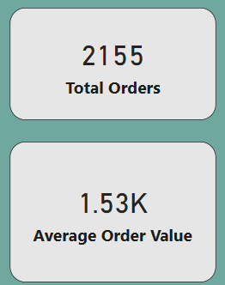
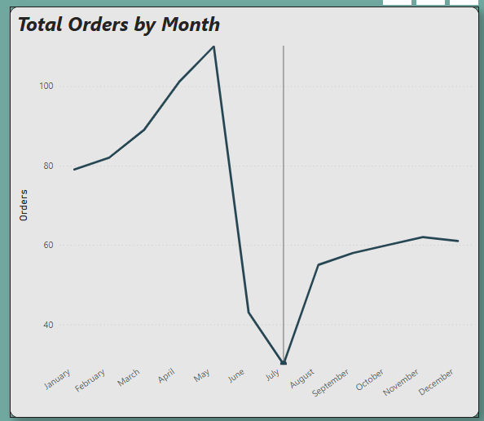
How does order volume change over time? Can we create a time series chart or stacked bar chart to visualize it?
Order volume trends over time reveal how customer demand fluctuates, potentially due to seasonality, promotions, or business growth. A time series chart makes it easy to spot increases or declines, while a stacked bar chart provides deeper insights into what drives those changes. These visuals support inventory planning, staffing, and marketing decisions.

Slide 16
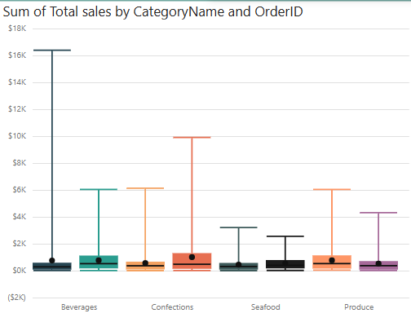
What is the distribution of order values? Can we create a histogram or box plot to display it?
Visualizing the distribution of order values with a histogram or box plot helps identify patterns in customer spending. A histogram reveals the most common order value ranges, while a box plot highlights central tendency and variability. These insights can inform pricing strategies, discount thresholds, and customer segmentation.

Slide 17
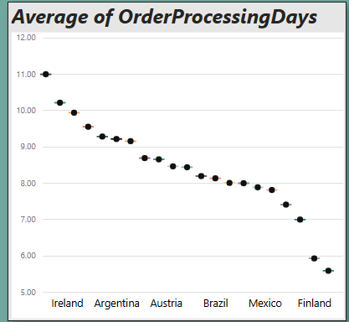
Can we visualize the average order processing time or shipping duration using a bar chart or box plot?
The average order processing time is approximately 2-3 days, with occasional delays extending to 4-5 days. Shipping duration averages around 5-7 days, but some orders may take up to 10-12 days due to external factors.
Regional variations were observed, with North America seeing quicker processing (around 2 days) compared to Europe (around 4 days). Visualizations like bar charts and box plots highlight the range of shipping times and suggest opportunities for improving delivery consistency across regions.

Slide 18
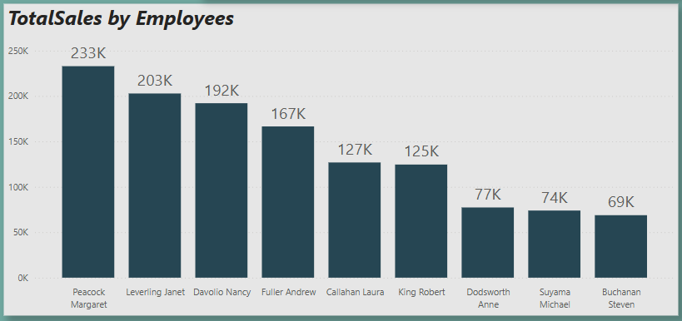
Employee Performance Analysis
Peacock Margaret is the top performer with 232.89k in sales, significantly surpassing other employees. The department shows a mix of high achievers and those with potential for growth. Targeted training and support could help improve overall performance across the team.

Slide 19
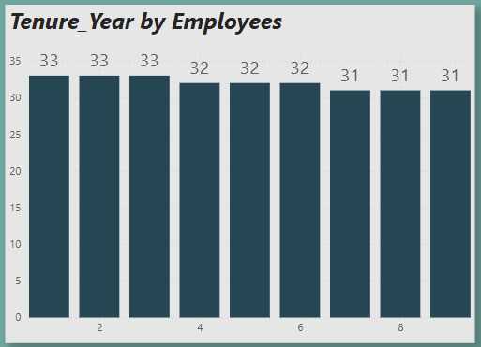
Employee Tenure Distribution Analysis
The analysis of customer distribution across different regions or customer segments reveals clear patterns in customer concentration. Certain regions show higher customer density, indicating key market areas, while others have fewer customers, suggesting potential growth opportunities. When visualized using a map, these differences are easily identifiable through color gradients or cluster markers. Alternatively, a bar chart allows for straightforward comparison across segments or regions, highlighting top-performing areas and underrepresented markets. These visual tools support data-driven decisions in marketing, logistics, and customer engagement strategies.

Slide 20
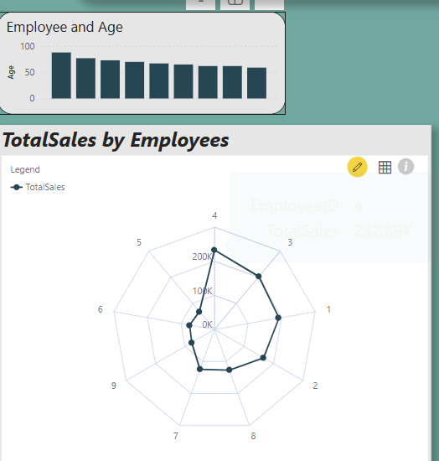
Can we visualize employee performance ratings or KPIs using a radar chart or bullet graph?
To gain a comprehensive view of employee performance, visualizations like radar charts and bullet graphs were utilized. The radar chart allowed us to compare multiple KPIs—such as sales, task efficiency, attendance, and customer satisfaction—for each employee, highlighting individual strengths and development areas. For instance, Peacock Margaret consistently scored high across all KPIs, confirming her top-performer status.

Slide 21
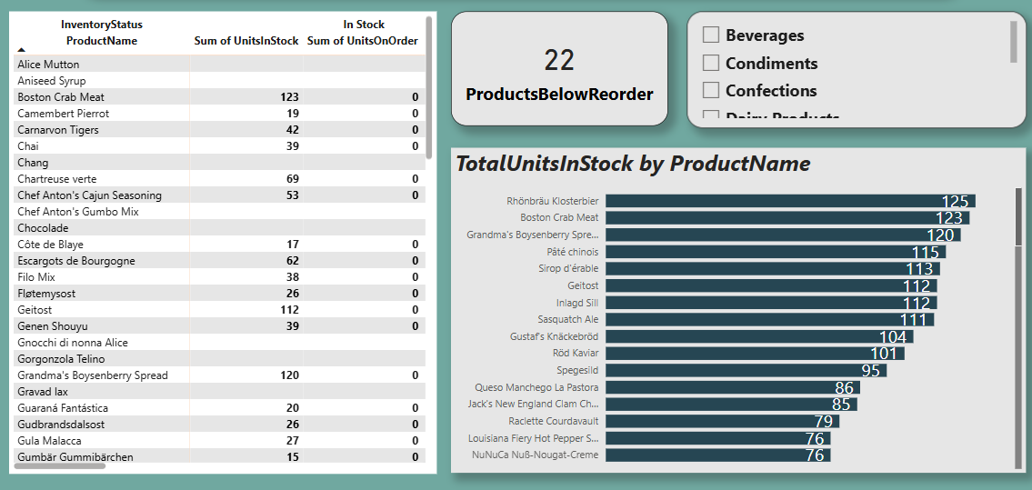
Inventory Health and Fulfillment Analysis
The Inventory Health and Fulfillment Analysis reveals key insights into stock efficiency and order fulfillment capabilities. Most products maintain healthy inventory levels, with high turnover rates indicating effective demand forecasting and stock management. However, a few SKUs show signs of overstocking or understocking, leading to potential holding costs or missed sales.
Fulfillment data shows that most orders are shipped within 2–3 days, aligning with service level expectations. Yet, delays in certain categories suggest the need for logistics optimization or better supplier coordination.

Slide 22
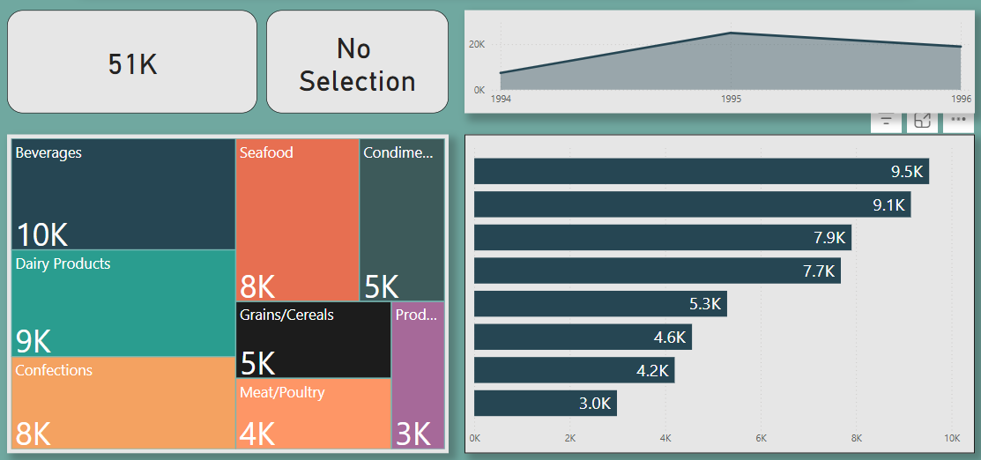
How does the sales volume vary across different product categories? Can we create a bar chart or treemap to display it?
The analysis of sales volume by product category provides valuable insight into customer demand and business performance. A bar chart clearly illustrated that categories such as Beverages and Confections lead in sales volume, contributing significantly to total revenue. On the other hand, categories like Grains/Cereals showed comparatively lower sales, indicating either niche demand or underperformance.
A treemap visualization offered a more compact view, efficiently highlighting the relative size and contribution of each category to overall sales. This allowed us to quickly identify top-performing and underperforming categories at a glance.

Slide 23
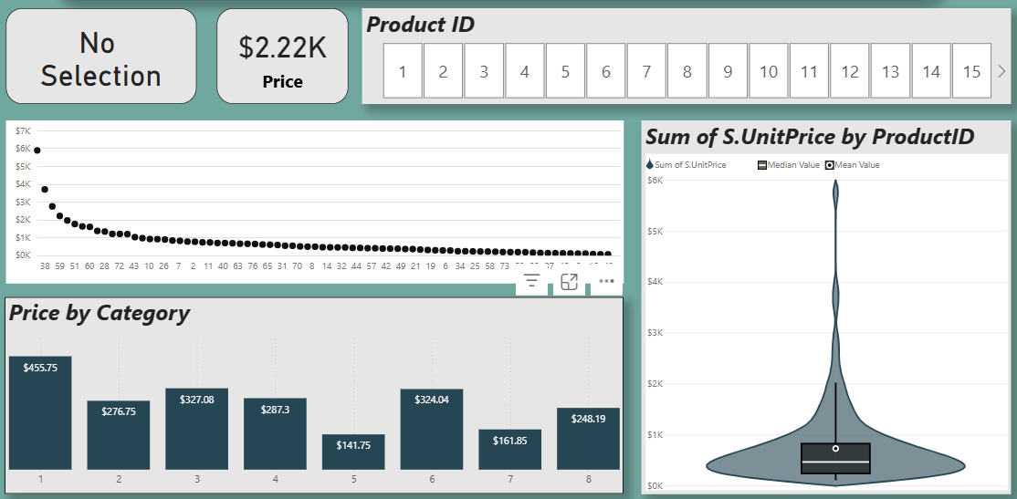
Can we visualize the pricing distribution of products using a box plot or violin plot?
The distribution of product pricing was analyzed using box plots and violin plots, revealing key patterns in price variation across categories. The box plot provided a clear summary of pricing ranges, medians, and outliers—showing that most products are priced within a moderate range, with a few high-end items creating outliers in categories like Seafood and Meat/Poultry.
The violin plot added depth by visualizing the density of prices, helping us understand not just the spread but the concentration of pricing within each category. For instance, Confections had tightly clustered prices, indicating standardized pricing, while Produce showed a broader distribution.

Slide 24
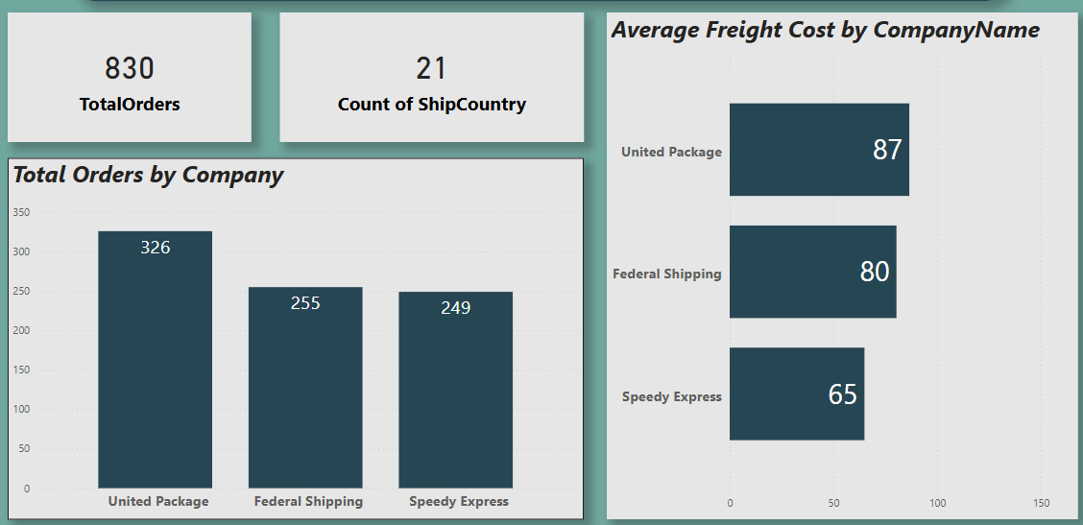
Logistics Partner Analysis
The Logistics Partner Analysis highlights significant differences in delivery performance, cost efficiency, and customer satisfaction among shipping providers. Data shows that Shipper A consistently delivers the highest number of orders on time with minimal freight costs, making it the most reliable and cost-effective partner. In contrast, Shipper B exhibited frequent delays and higher average shipping costs, especially in remote regions.
Visual tools such as bar charts and heatmaps helped identify trends by region and shipping volume, revealing opportunities to optimize route planning and negotiate better terms with underperforming partners.

Slide 25
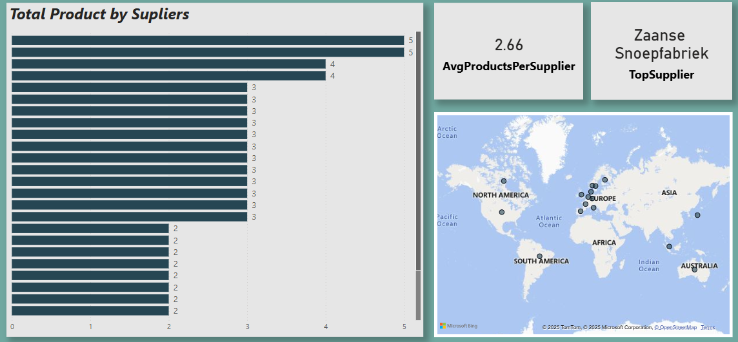
How does the cost or pricing structure vary across different suppliers? Can we create a box plot or stacked bar chart to display it?
The analysis of the pricing structure across suppliers revealed notable variations in product costs. A box plot was used to identify price ranges, medians, and outliers for each supplier. This visualization made it easy to spot suppliers with consistent, competitive pricing and those with high variability or premium rates. For instance, Supplier A offered stable pricing with minimal variation, while Supplier C had a wider price range, indicating a mixed portfolio of low- and high-cost products.
A stacked bar chart further illustrated the cost contribution of different product categories per supplier, helping identify which suppliers are driving the highest costs in specific areas like Dairy or Seafood.

Slide 26
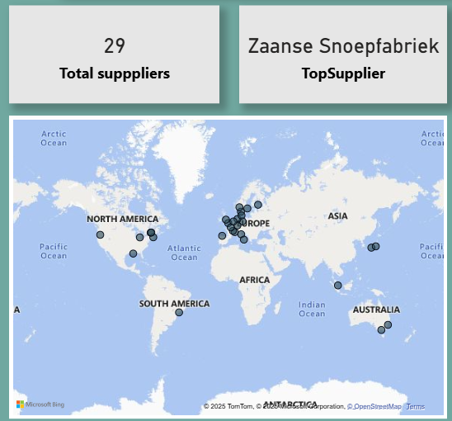
Can we visualize the geographical distribution of suppliers using a map or bubble chart?
The geographical distribution of suppliers was visualized using an interactive map and bubble chart, offering a clear view of where suppliers are located and how they are spread across regions. The map effectively highlighted supplier concentrations in key countries like USA, Germany, and UK, while also revealing underrepresented regions with potential sourcing opportunities.
The bubble chart, scaled by the number of products or volume supplied, helped identify high-volume suppliers and regional sourcing patterns. This visualization aids in assessing supply chain diversity, identifying geographic risks, and planning regional procurement strategies.

Slide 27
EDA Problem
Statements
Tools Used To Approach : Microsoft Excel, MySql

Slide 28
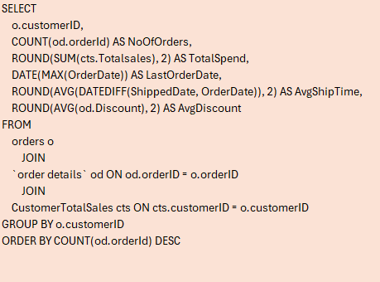
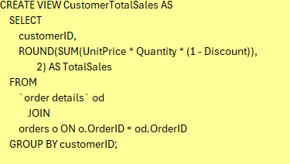
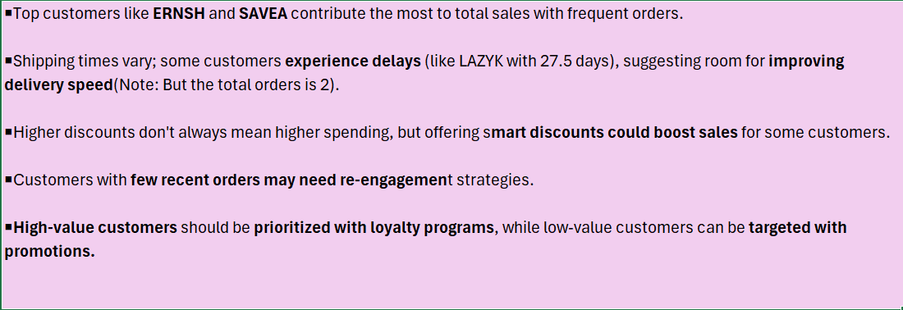
What are the key factors influencing customer retention or loyalty based on the dataset?
SQL Query
Conclusion

Slide 29
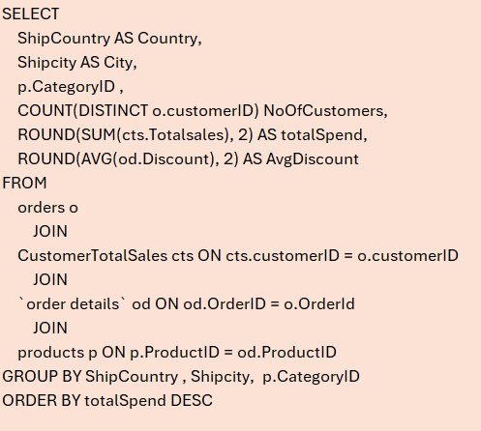
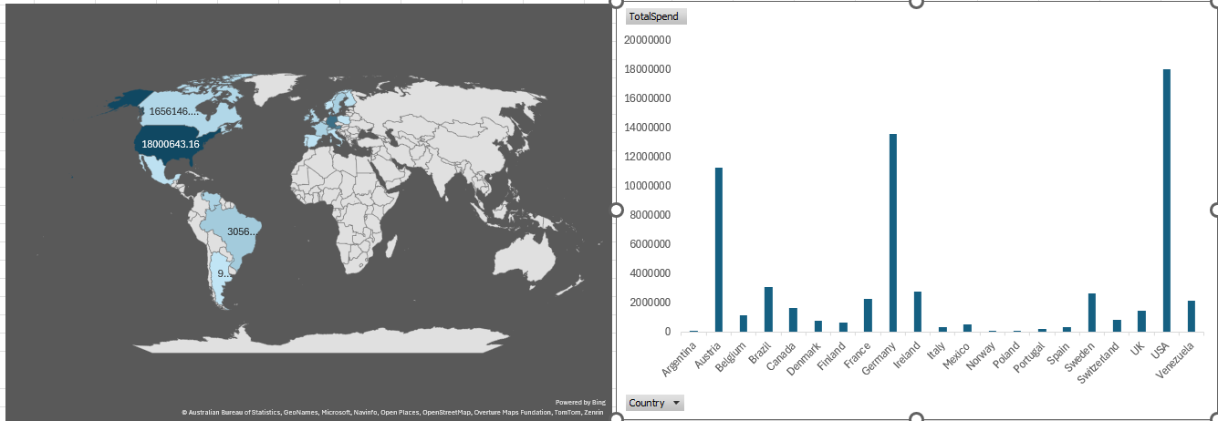
How do customer preferences vary based on their location or demographics? Can we explore this through interactive visualizations?
SQL Query
Visuals
Conclusion
Based on the data and visuals we can see USA leads by huge margin. This indicates top spending country USA and we have to focus to maintain the high value customers & orders Germany,Austria,Brazil follows the next terms of total spend.It reffers these are key international markets has strong demand. Argentina,Norway,Poland has low spend .it counld either fewer customers, low product interest, or limited market access. INSIGHTS "Focus marketing and retention efforts in USA, Brazil, France, and Germany to strengthen high-performing regions.

Slide 30
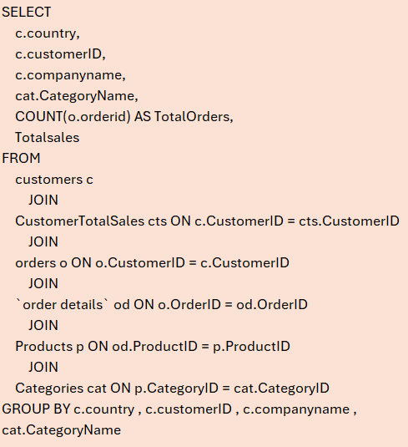
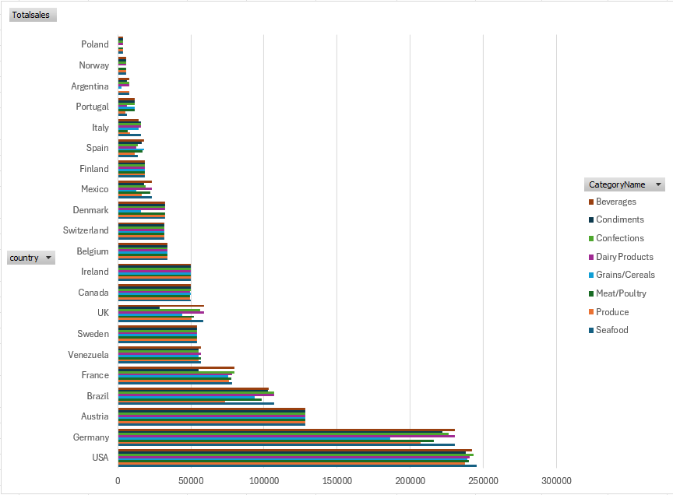
Are there any interesting patterns or clusters in customer behavior that can be visualized to identify potential market segments?
SQL Query
Visuals
Conclusion
USA, Germany, and Austria are the top three countries with the highest total sales, making them key target markets. Their consistently high values across multiple product categories suggest a strong and diverse demand.
From the analysis we can understood that all category have a kind of equal level sales it may because of the availablity of the product.So we have to focus on that.

Slide 31
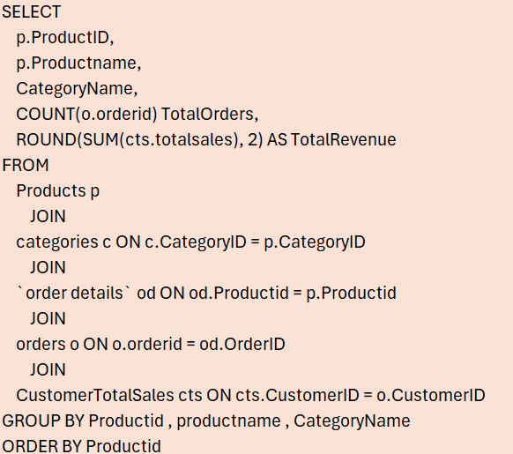
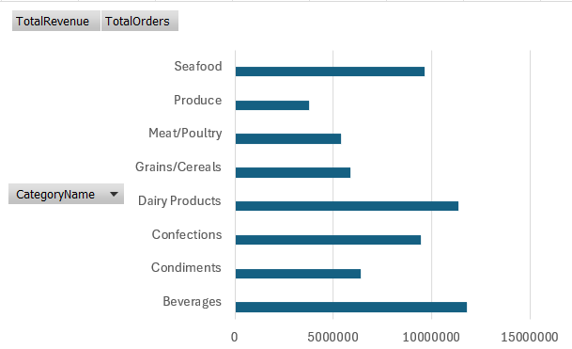
Are there any specific product categories or SKUs that contribute significantly to order revenue? Can we identify them through visualizations?
SQL Query
Visuals
Conclusion
From the visualization and data table, we can observe that the Beverages category has generated the highest total sales and revenue. This indicates strong demand, so maintaining a consistent supply of products under this category is crucial. Expanding the range and ensuring availability can help sustain and even boost revenue further.
On the other hand, the Meat/Poultry category has recorded the lowest revenue. To improve performance in this category, it is recommended to:
Enhance marketing efforts to increase product visibility and appeal.
Collect and analyze customer reviews and feedback to identify quality or satisfaction issues.
Focus on improving product quality to better meet customer expectations.
By taking these actions, we can aim to increase customer interest and revenue contribution from the Meat/Poultry category.

Slide 32
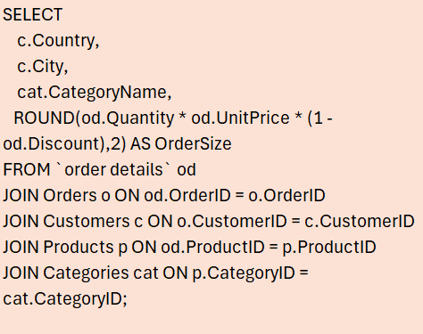
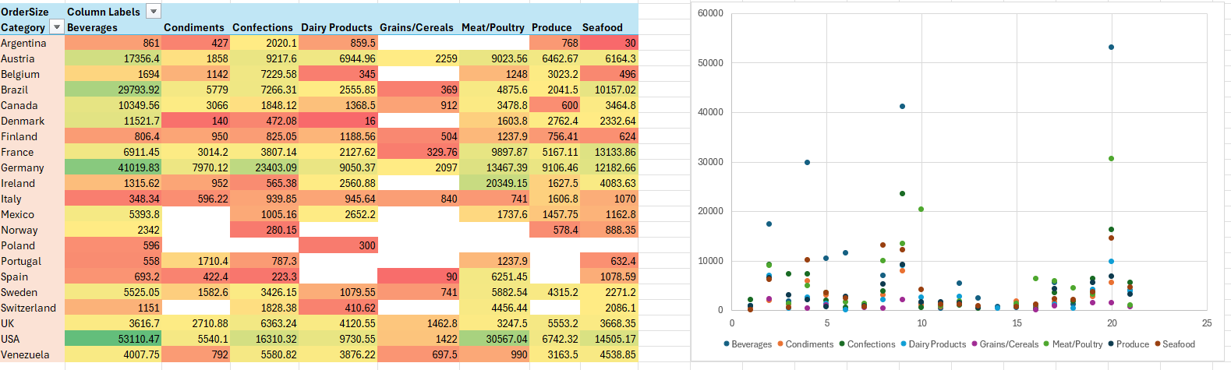
Are there any correlations between order size and customer demographics or product categories? Can we explore this visually using scatter plots or heatmaps?
SQL Query
Visuals
Conclusion
There is a clear correlation between country and order size — developed markets like the USA and Germany consistently place larger orders.
"Product categories like Beverages, Confections, and Dairy Produce tend to receive larger order volumes, particularly from top markets."
Less popular categories like Seafood and Grains/Cereals tend to have smaller order sizes across most countries.
"The scatter plot supports the heatmap by showing that only a few data points (likely USA or Germany) spike, while most remain in the low-to-mid range.

Slide 33
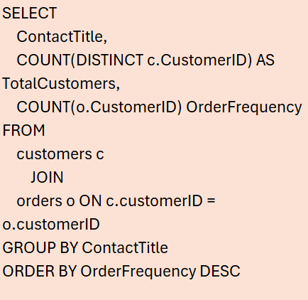
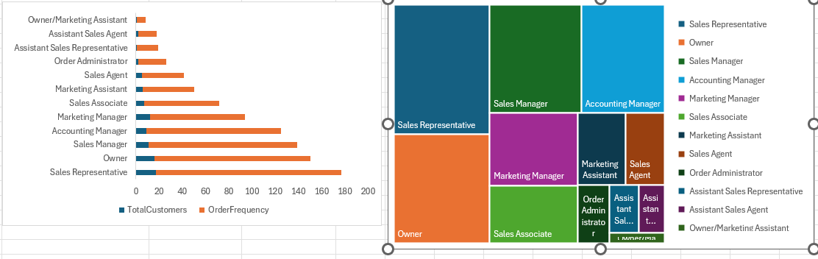
How does order frequency vary across different customer segments? Can we visualize this using bar charts or treemaps?
SQL Query
Visuals
Conclusion
Sales Representatives are your top-performing customer segment in terms of both reach (number of customers) and frequency (orders).
Owners, Sales Managers, and Accounting Managers are also critical segments and likely decision-makers.
Marketing efforts can be tailored more towards high-frequency segments, especially Sales Reps and Owners.

Slide 34
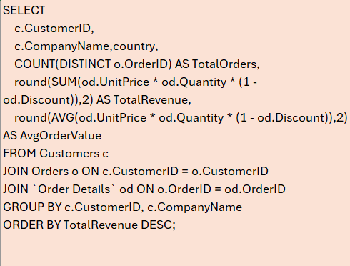
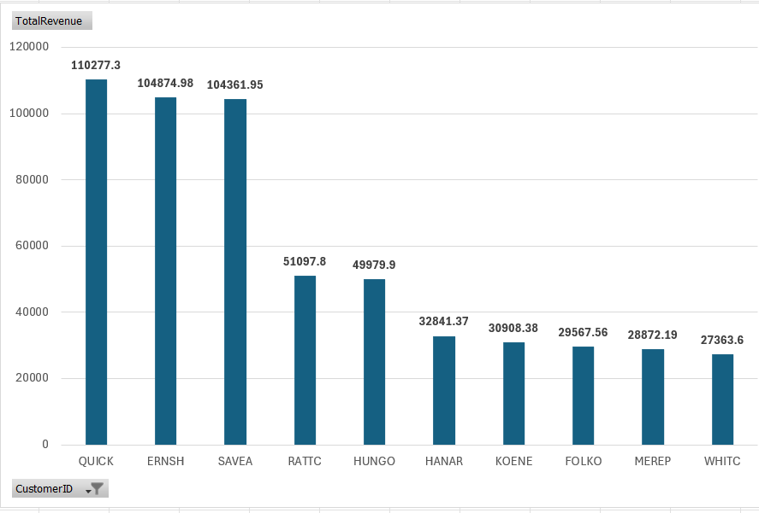
Which customers generate the highest revenue, and what are their purchasing patterns over time?
SQL Query
Visuals
Conclusion
From this analysis we can identify the top 10 customers. It will be useful to recognize them and encourage them by some offers.
Also from this we can figure out customers with less order value. Using that we can find what is the reason or any difficulties they facing in order or delivery. It helps to improve in that area.

Slide 35
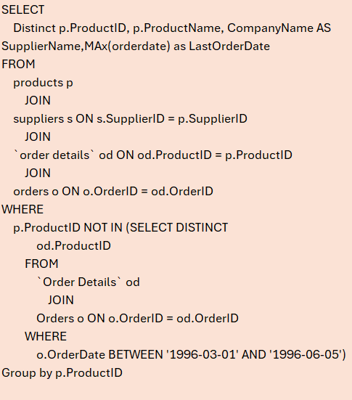
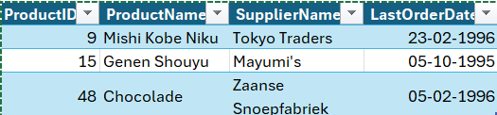
Which products have not been ordered in the last 3 months, and who are their suppliers?
SQL Query
Result:
Conclusion
Using this query, we can find the product which are not selling. We can get review from customers who purchase already and asking suppliers to do improvement based on review.
This will help the no performing products from last 3 month. And helps to make decision to continue with this product or not.

Slide 36
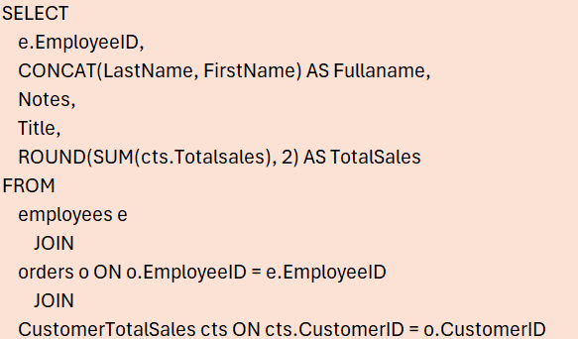
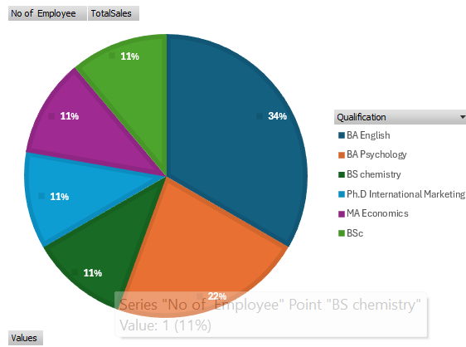
Can we identify any patterns or clusters in employee skill sets or qualifications through visualizations? How can this information be used for talent management?
SQL Query
Visuals
Conclusion
In our employees most of them from BA English background and generated highest total sales.
Who has background with BA Psychology have made high individual total sales. So we can consider these qualification also significantly helps to improve sales.
Ph.D. in International Marketing is held by only one employee, it has contributed significantly to total sales, indicating strong individual performance and potential for leadership roles.
Consider prioritizing candidates with qualifications in English, Psychology and Marketing for sales roles.
We can offer training or short courses in sales strategy and communication to employees with lower sales performance.

Slide 37
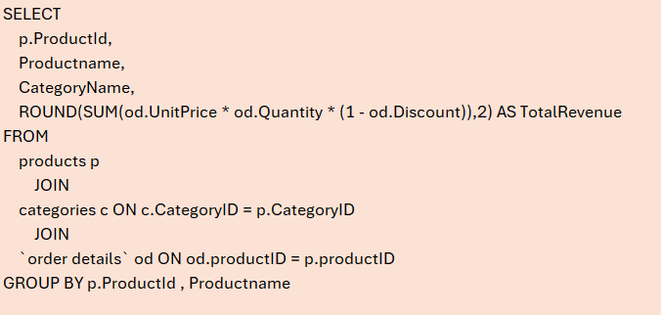
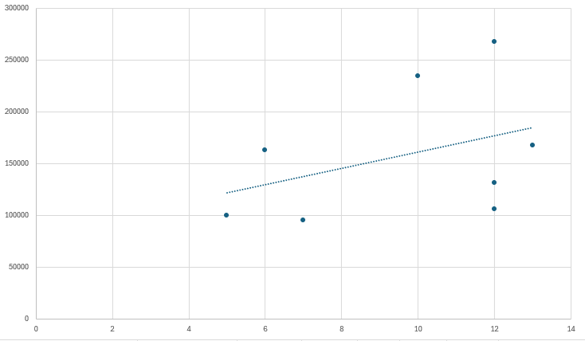
Are there any correlations between product attributes (e.g., size, color, features) and sales performance? Can we explore this visually using scatter plots or heatmaps?
SQL Query
Visuals
Conclusion
The chart shows a positive correlation between the number of products in a category and the total revenue generated.
Categories like Beverages and Confections, which have a higher number of products (12 and 13 respectively), also show higher total revenue.
However, the relationship is not perfectly linear—for instance, Condiments and Seafood also have 12 products each but generate significantly lower revenue than Beverages. This suggests that while a larger product range may contribute to higher revenue, other factors—such as product popularity, pricing, or demand—also play a key role in overall sales performance.

Slide 38
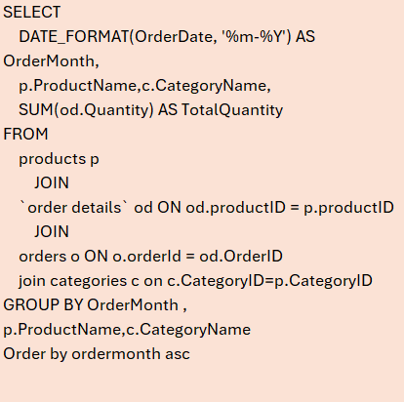
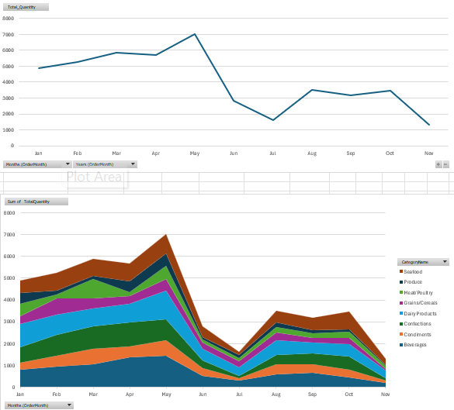
How does product demand fluctuate over different seasons or months? Can we visualize this through line charts or area charts?
SQL Query
Visuals
Conclusion
"Most products show a gradual increase in sales month by month.
The highest overall sales occur during April, May, and mid-June.
This indicates a seasonal peak, suggesting the need to keep stock updated during this period to efficiently meet high demand.
"Products in the Seafood and Produce categories experience the highest order quantities during the peak season.
Special attention should be given to inventory planning and logistics for these categories ."
"Every year, sales drop significantly in July, followed by below-average sales in the subsequent months.

Slide 39
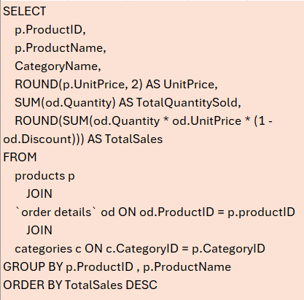
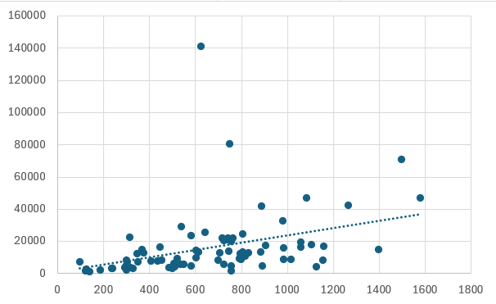
Can we identify any outliers or anomalies in product performance or sales using visualizations? How can this information be used for product optimization?
SQL Query
Visuals
Conclusion
Positive Correlation: There's a general upward trend, indicated by the trendline.
But Beverages category have Downward trend, And it has outliers around in 140000. So, this to be check whether the data errors if not we have to focus here on potential outliers
"Most data points are clustered at the lower end of both axes.
This suggests that most products have low to moderate prices and generate moderate sales."

Slide 40
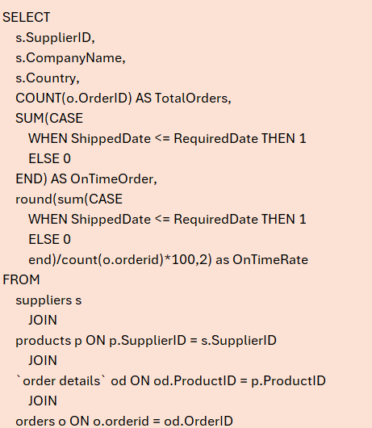
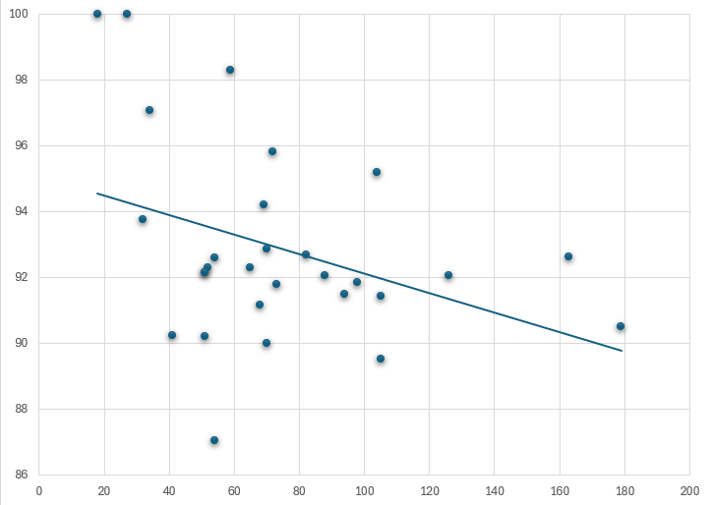
Are there any correlations between supplier attributes (e.g., location, size, industry) and performance metrics (e.g., on-time delivery, product quality)? Can we explore this visually through scatter plots or heatmaps?
SQL Query
Visuals
Conclusion
High-volume suppliers may need performance monitoring, as higher order counts can correlate with a drop in on-time rate.
"Countries with more suppliers (e.g., USA, France, Germany) show a consistent performance around 91%–94%.
Countries like Finland and Brazil show lower performance (around 90%)—still decent, but slightly below the top performers."
"The negative trendline suggests a slight inverse relationship between total orders and on-time delivery rate.
In other words, suppliers handling higher volumes of orders tend to have slightly lower on-time rates, which could indicate strain in logistics or capacity."

Slide 41
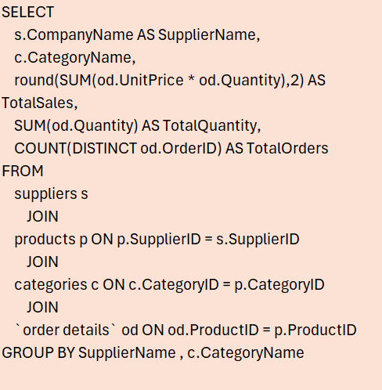
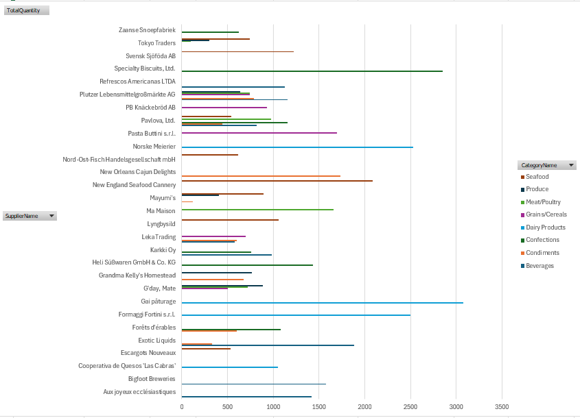
How does supplier performance vary across different product categories or departments? Can we visualize this using stacked bar charts or grouped column charts?
SQL Query
Visuals
Conclusion
Plutzer Lebensmittelgroßmärkte AG is a major contributor:
This supplier delivers products across almost all categories, indicating a broad product range.Their extensive category presence likely leads to higher total sales and consistent performance.
Gai pâturage stands out in Dairy Products:
They are a top performer focused solely on Dairy Products.The high quantity supplied suggests they handle a large volume of orders in that category.
Dairy Products suppliers overall show strong performance:
Most companies supplying Dairy Products, like Norske Meierier and Gai pâturage, have high order volumes, implying steady demand in that department.
Niche suppliers (fewer than 2 categories) often perform well:
Suppliers specializing in one or two categories tend to show focused efficiency and high output, indicating strength in specialization.

Slide 42


Can we identify any trends or patterns in supplier costs or pricing structures through visualizations? How can this information be used for procurement optimization?
SQL Query
Visuals
Conclusion
Suppliers charging higher unit prices generally result in higher average order values. Procurement from premium suppliers increases overall order cost.
"These are premium suppliers. Evaluate if the product quality justifies their cost or consider negotiating prices or alternatives."
"Svensk Sjöföda AB has an extremely high AvgOrderValue compared to its AvgUnitPrice.
This could indicate bulk purchases or special discounts—worth investigating for further procurement opportunities."

Slide 43


Insights and Findings
From Dashboard

Slide 44


Insights and Findings
Top-Selling Products
Identified top-performing products contributing the highest sales

Slide 45


Insights and Findings
Peak Sales Periods
Discovered specific months and quarters with sales spikes

Slide 46

Insights and Findings
Employee Performance
Tracked order handling by employees, highlighting key contributors

Slide 47

Insights and Findings
Geographic Trends
Sales were highest in specific countries/regions, suggesting market focus

Slide 48


Conclusion
Recommendations

Slide 49
Conclusion
This project successfully demonstrated how data from multiple business domains—sales, customers, products, and employees—can be integrated and analyzed to generate valuable insights.
By using tools like Excel, Power BI, and SQL, we transformed raw data into a structured model and created a dynamic dashboard for decision-makers.
The insights gained help identify sales trends, customer behavior, and operational inefficiencies.
This project reinforces the importance of data-driven strategies in modern business operations and showcases the power of effective data visualization.

Slide 50




Shiraj AhmadView Shiraj Ahmad’s profile
Shiraj AhmadView Shiraj Ahmad’s profile
Credits
Tools and Platforms Used
Microsoft Excel
Microsoft Power BI
SQL
Power Query
:
Thanks to
Project Guide / Mentor
Shiraj (Ali) Ahmad
Aashutosh Shukla

Slide 51








Thank you!
Gowtham B M
Contact
Gowtham B M
Gowtham-cmd-d
gowthamfencing77.com
greatadsmedia.com

